Slide 1
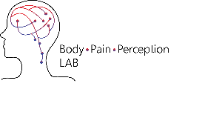

Modelling perceptual uncertainty in a thermosensory illusion across the lifespan
Jesper Fischer Ehmsen
Body Pain & Perception Lab, Aarhus University
25th September 2025
jesperfischer@cfin.au.dk
Jesper F. Ehmsen - jesperfischer@cfin.au.dk
Notes:
Today im talking about a thermosensory illusion, called the paradoxical heat sensation that refers to the phenomenon of the skin being cooled, but subjects feeling warmth or heat.
In this study we investigated this illusion with a paradigm that heats the skin to a peak temperature and then afterwards cooled down all with a thermode. After the thermode reached skin-temperature subjects where asked to report when they feel a change in sensation and what this sensation was (cold or warm)

Slide 2


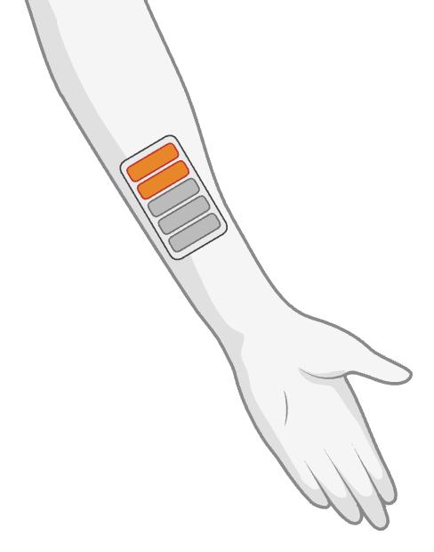

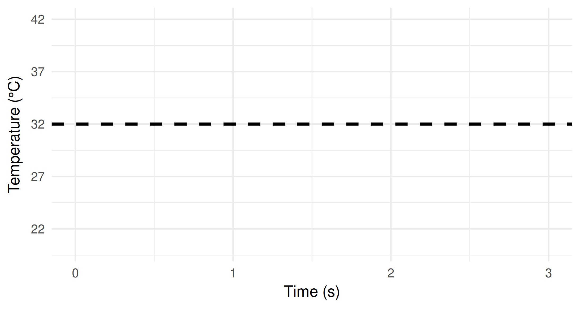
Warm stimulus
Aims
Decision making process
Age & neuropathy
Aims
Decision making process
Age
Aims
Decision making process
Cool stimulus
+
Press ‘up’ when you perceive a change in sensation.
Response
Which temperature did you feel?
Confidence
How confident are you in your reported sensation?
Time
cold
warm
Guess
Certain
Thermal Contrast (TC)
Mitchell, A. G., et al. (2024). Communications Psychology
Jesper F. Ehmsen - jesperfischer@cfin.au.dk
Notes:
Then at a certain point the temperature starts cooling.
Subjects are instructed to respond on a keyboard when they feel a change in sensation, but only after the presentation of an auditory tone.
After the auditory tone, subjects then at some point indicate a change in sensation (i.e. the first response).
Then they have to decide whether the temperature was cold or warm
And lastly they give a confidence rating on this binary decision.
What we have previously shown is that thermal constrant (the distance here) is predictive of the binary response (cold or warm) with higher thermal contrast being associated with a higher probability of responding PHS (i.e. warm).
However this study was quite limited in the number of trials like most of the PHS-litterature.
So we set out to manipulate thermal contrast but manipulating the peak temperature and increasing the number of trials.

Slide 3
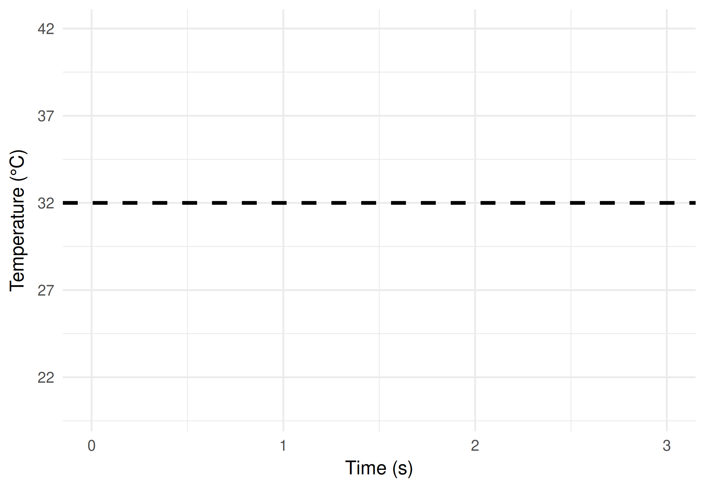
Warm stimulus
HC = 75
NP = 32 Trials = 56 (8)
Cool stimulus
+
Press ‘up’ when you perceive a change in sensation.
Response
Which temperature did you feel?
Confidence
How confident are you in your reported sensation?
Time
cold
warm
Guess
Certain
Thermal Contrast (TC)
0.00 s
0.10 s
0.20 s
0.30 s
0.40 s
Guess
Certain
0.00 s
0.10 s
0.20 s
0.50 s
0.60 s
0.00 s
0.10 s
0.20 s
0.30 s
0.40 s
0.70 s
0.80 s
0.90 s
1.00 s
1.10 s
0.50 s
0.60 s
0.00 s
0.10 s
0.20 s
0.30 s
0.40 s
0.70 s
0.80 s
0.90 s
Guess
Certain
Guess
Certain
1.00 s
Guess
Certain
Jesper F. Ehmsen - jesperfischer@cfin.au.dk
Notes:
Here one can see how changing the peak temperature manipulates the thermal contrast.

Slide 4
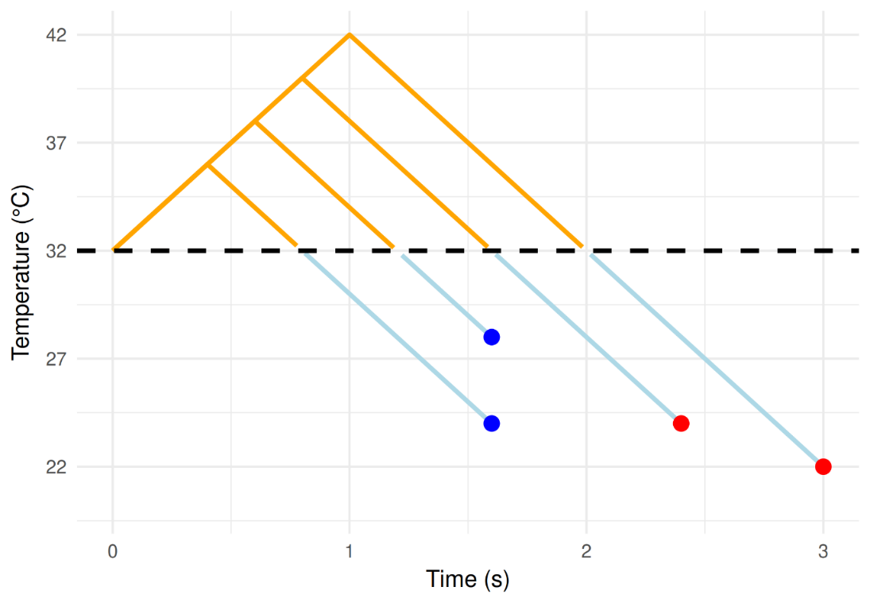
Warm stimulus
HC = 75
NP = 32 Trials = 56 (8)
Cool stimulus
+
Press ‘up’ when you perceive a change in sensation.
Response
Which temperature did you feel?
Confidence
How confident are you in your reported sensation?
Time
cold
warm
Guess
Certain
0.40 s
Guess
Certain
0.20 s
1.10 s
Guess
Certain
Guess
Certain
1.00 s
Guess
Certain
Thermal Contrast (TC)
Jesper F. Ehmsen - jesperfischer@cfin.au.dk
Notes:
Here one can see how changing the peak temperature manipulates the thermal contrast.

Slide 5
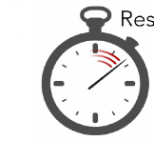
Response
HC = 75
NP = 32 Trials = 56 (8)
Which temperature did you feel?
cold
warm
Response time
Confidence
How confident are you in your reported sensation?
Guess
Certain
Ehmsen, J. F et al. (2025). Modelling perceptual uncertainty in a thermosensory illusion across the lifespan. bioRxiv.
Jesper F. Ehmsen - jesperfischer@cfin.au.dk
Notes:
We also collected the response time to the second decision of whether the temperature was cold and warm as well as the subjects’ confidence in their decision.
Generally, one can observe that in decision making tasks that response time and confidence ratings are highly influenced by the uncertainty of the decision making task, which amounts to a peak around the psychometric function's threshold with increases (decreases for confidence ratings) around the threshold (the true-perceiver), here we investigated whether this was also the case for making decisions of a thermosensory “illusion”, but contrasting it to a “unsure perceiver” where uncertainty scales with the probability of reporting PHS, due to the inherent weirdness of the PHS.
We found that generally across our sample that the “unsure perceiver” better described our data, which can be seen in these plots
Lastly, another primary interest was how age affected the PHS-threshold the response times and confidence ratings. Here we found that the threshold decreased, response time decreased and confidence increased.
This means that for healthy subjects uncertainty with regards to reporting PHS scales with the probability of PHS and that as they age they will report PHS more frequently at the same thermal contrast, while generally being slower and more confident in their decisions.
This is a pre-regresration and we thought of this
Both the model comparison and the PHS threshold.
Other literature.
Other colors

Slide 6
Response
HC = 75
NP = 32 Trials = 56 (8)
Which temperature did you feel?
cold
warm
Response time
Confidence
How confident are you in your reported sensation?
Guess
Certain
Ehmsen, J. F et al. (2025). Modelling perceptual uncertainty in a thermosensory illusion across the lifespan. bioRxiv.
Jesper F. Ehmsen - jesperfischer@cfin.au.dk
Notes:
We also collected the response time to the second decision of whether the temperature was cold and warm as well as the subjects’ confidence in their decision.
Generally, one can observe that in decision making tasks that response time and confidence ratings are highly influenced by the uncertainty of the decision making task, which amounts to a peak around the psychometric function's threshold with increases (decreases for confidence ratings) around the threshold (the true-perceiver), here we investigated whether this was also the case for making decisions of a thermosensory “illusion”, but contrasting it to a “unsure perceiver” where uncertainty scales with the probability of reporting PHS, due to the inherent weirdness of the PHS.
We found that generally across our sample that the “unsure perceiver” better described our data, which can be seen in these plots
Lastly, another primary interest was how age affected the PHS-threshold the response times and confidence ratings. Here we found that the threshold decreased, response time decreased and confidence increased.
This means that for healthy subjects uncertainty with regards to reporting PHS scales with the probability of PHS and that as they age they will report PHS more frequently at the same thermal contrast, while generally being slower and more confident in their decisions.
This is a pre-regresration and we thought of this
Both the model comparison and the PHS threshold.
Other literature.
Other colors

Slide 7
Summary
Healthy controls: behave like unsure perceivers when reporting PHS.
Age: increases PHS threshold, response time, and reduces confidence.
Neuropathic pain patients: higher PHS threshold, but normal response times and confidence.
Jesper F. Ehmsen - jesperfischer@cfin.au.dk
Notes:
Backup on the patients: Patients were recruited from a sample diagnosed as having probable neuropathy based on the Toronto consensus grading system, as part of other projects within the framework of the Danish National Type 2 Diabetes (DD2) cohort

Slide 8
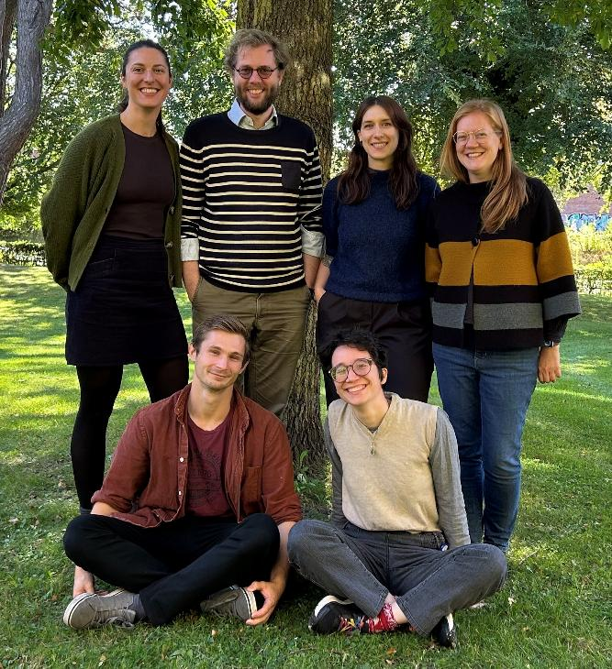
Thank you
Body Pain Perception Lab
Alexandra G. Mitchell
Arthur S. Courtin
Rebecca Astrid Böhme
Francesca Fardo
Kora Montemagno
Camilla Eva Krænge
Jesper F. Ehmsen - jesperfischer@cfin.au.dk
Notes:
Backup on the patients: Patients were recruited from a sample diagnosed as having probable neuropathy based on the Toronto consensus grading system, as part of other projects within the framework of the Danish National Type 2 Diabetes (DD2) cohort

Slide 9
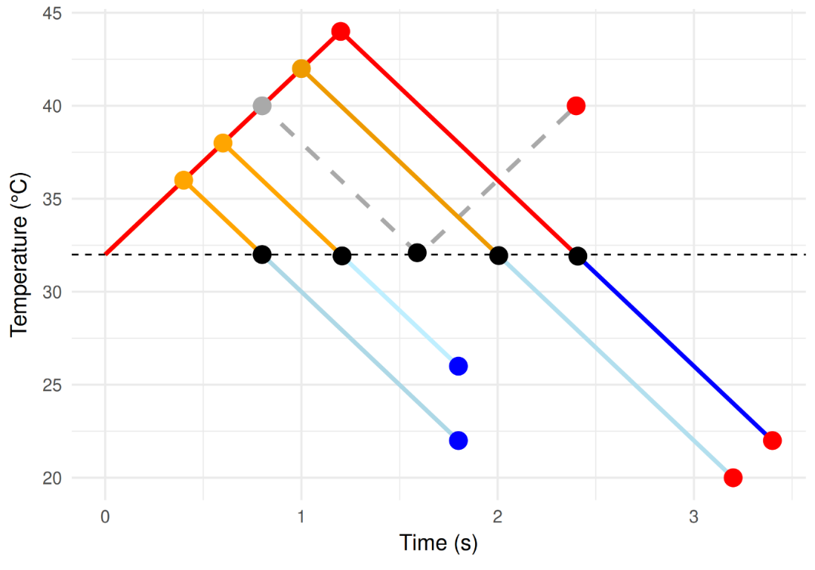
Warm stimulus
Subjects = 75 Trials = 64 (6)
Cool stimulus
+
Press ‘up’ when you perceive a change in sensation
After the tone
Response
Which temperature did you feel?
Confidence
cold
warm
How confident are you in your reported sensation?
Guess
Certain
Thermal Contrast (TC)
Jesper F. Ehmsen - jesperfischer@cfin.au.dk
Notes:
Using thermal contrast as the x-axis our previous study showed that the probability binary choices of saying (Warm) i.e. PHS should increase with increasing thermal contrasts.

